Slide 1
Neural Networks Lab
Artificial intelligence

Slide 2
Build the Neural Network Model
model = tf.keras.Sequential([
tf.keras.layers.Dense(units=, input_shape=[], activation='')])

Slide 3
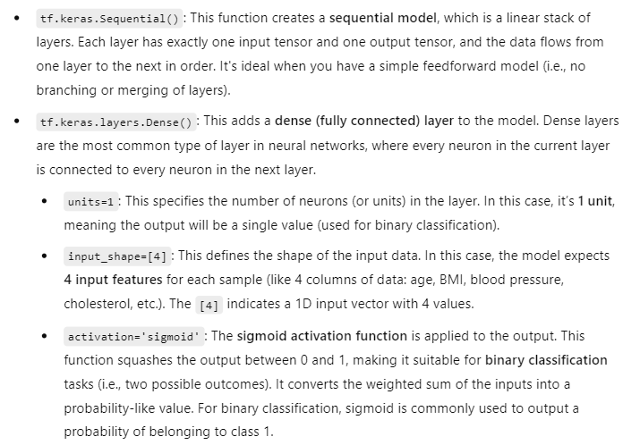

Slide 4
Compile the Model
model.compile(optimizer='', loss='', metrics=[''])

Slide 5
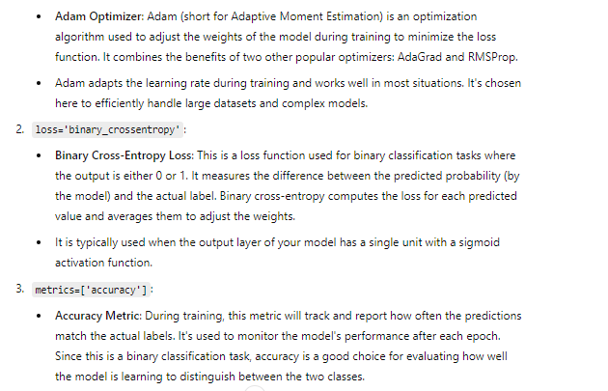

Slide 6
Train the Model
model.fit(data, labels, epochs=)

Slide 7
Make a Prediction
prediction = model.predict ([[,s ,s, s]])
print(prediction[0][0])

Slide 8
Prediction
if prediction[0][0] > 0.5: print(“event A.")
else: print(" event B ")

Slide 9
